Slide 1

DEPARTMENT OF COMPUTER SCIENCE Project Presentation (BCS 554) Using existing CCTV network for crowd management, crime prevention, and work monitoring using AI/ML
Under the supervision of
Dr. Rajkumar sir (Additional Head of Department)
Project member details:
Aarohi Saxena 2200291520002 Sec- B

Slide 2
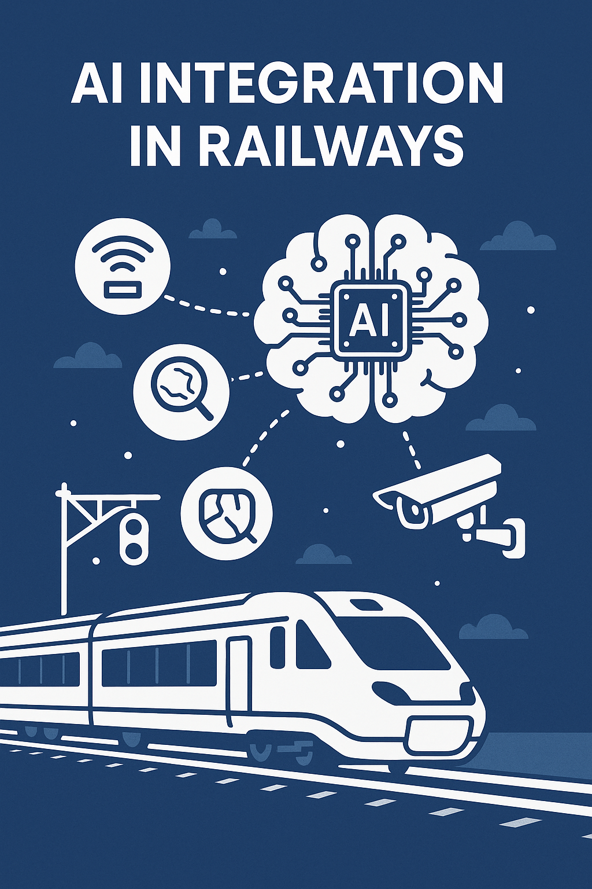
Problem Statement
Indian Railways faces challenges in managing crowds, cleanliness, crime prevention, and work monitoring.
Manual surveillance is time-consuming and prone to human error.
AI and ML can enhance CCTV systems by providing real-time data analysis for detecting anomalies and improving operational efficiency.
AI can detect unusual behavior, and ML can predict crowd patterns for better resource management.
Significant investment in technology and infrastructure is required to implement AI-based CCTV systems.
Privacy and ethical considerations must be addressed to protect passengers' rights.
Proper planning and implementation are essential for success.

Slide 3
Objectives
Leverage ML algorithms to analyze video feeds in real-time, detecting unusual behavior, overcrowding, and potential safety risks.
Automate crime detection by identifying suspicious activities and alerting security personnel promptly.
Optimize resource management through the prediction of crowd patterns, enabling better staff and resource allocation.
Ensure effective work monitoring by tracking activities such as station cleanliness and maintenance operations to ensure adherence to standards.
Integrate with web-based technologies for a user-friendly interface to manage surveillance, reporting, and decision-making without relying on cloud or edge computing infrastructure.

Slide 4
Technology Used
1. ML Models: ResNet50 (CNN): For real-time anomaly detection in video frames.
2. Programming Languages:
- Python: For implementing ML models and backend logic.
- JavaScript: For building the web portal UI.
3. Image Processing:
- OpenCV: For frame extraction and preprocessing.
4. Web Development:
- HTML/CSS/JavaScript with React or Angular for a dynamic user interface.
- Flask/Django or Node.js for backend operations and API handling.
5. Database: MySQL/PostgreSQL for storing anomaly data and logs.
6. Alert System:
- Twilio API for SMS/Email alerts.
- WebSockets for real-time notifications on the portal.
7. Audio Alerts: Python Libraries for triggering sound notifications.
8. Ambulance Integration: RESTful APIs for future integration with medical services.

Slide 5
Literature Survey
Paper Title | Author name | Journal name | Year of publishing | Summary
A Review on Deep Learning Techniques for Railway Infrastructure Monitoring | Maria Di Summa, Maria Elena Griseta , Nicola Mosca , Cosimo Patruno | IEEE Access | 2020 | The research paper titled "A Review on Deep Learning Techniques for Railway Infrastructure Monitoring" provides a comprehensive overview of the application of deep learning (DL) methods in monitoring railway infrastructure for preventive maintenance. The authors emphasize the dual nature of deep learning's feature extraction capabilities, which, while powerful, can also create challenges due to their "black box" nature.
Rail Track Monitoring Using AI and Machine Learning | Konstantin Popov, Robert DeBold, Hwa Kian Chai | Trends on Construction in the Digital Era | 2022 | The authors conclude the book by illustrating a vision for the future of railway monitoring systems by claiming science and technology to triumph with challenges proper monitoring will pose and demanding a better business case for general instrumentation of railway lines and demonstrating the effectiveness of new systems
Crowd Detection and Analysis for Surveillance Videos using Deep Learning | Aman Ahmed; Prateek Bansal; Atiya Khan; Neha Purohit | ICESC | 2020 | A new approach has been proposed for the research paper by the use of CNN and MRF for counting people in still images. The authors devised a technique that can bypass the crowd density estimation defects. That was achieved by dividing its image into overlapping patches. This gives crowds more uniformity in smaller areas, so the accuracy of the local crowd counts is higher
Anomaly detection based on Artificial Intelligence of Things: A Systematic Literature Mapping | HC chug, FS Dwell, G.J Kyan | ICESC | 2022 | The research paper entitled "Anomaly detection based on Artificial Intelligence of Things: A Systematic Literature Mapping" encompasses AIoT concepts integrated with EC and TinyML toward anomaly detection.

Slide 6
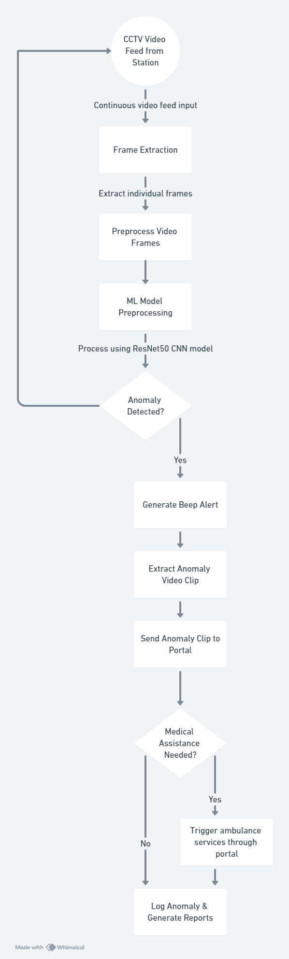
Diagrams

Slide 7
Patent Status
Applied for the patent.
Link: Annexure- https://docs.google.com/document/d/1Utvi7-ksUWMUrBSl8U5BhedsQWbDSiya/edit?usp=sharing&ouid=115762999925761984349&rtpof=true&sd=true
IDF Format: https://docs.google.com/document/d/1dCtQHZNbGWAHv5ACJ7nLhCz7Y1SPNrPo/edit?usp=sharing&ouid=115762999925761984349&rtpof=true&sd=true

Slide 8
Research Paper Status
Proof submission/ publication (Screenshot).
Hyperlink of the paper: https://docs.google.com/document/d/14qZ718AXJW3rBku23StPE9DgAUn8xSTL/edit?usp=sharing&ouid=115762999925761984349&rtpof=true&sd=true

Slide 9
Project Status 70 percent completed
https://github.com/Aarohisaxena/Major-Project

Slide 10
References
Maria Di Summa, Maria Elena Griseta , Nicola Mosca , Cosimo Patruno, “A Review on Deep Learning Techniques for Railway Infrastructure Monitoring”
Konstantin Popov, Robert DeBold, Hwa Kian Chai, “Rail Track Monitoring Using AI and Machine Learning” , ResearchGate
Sayali Bodake, Dr. S.S. kadam, “Crowd Detection Using Deep Learning” International Research Journal of Engineering and Technology (IRJET) Volume: 08 Issue: 08 | Aug 2021
Sergio Trilles, Sahibzada Saadoon Hammad, Ditsuhi Iskandaryan “Anomaly detection based on Artificial Intelligence of Things: A Systematic Literature Mapping”, Internet of Things, Volume 25 April 2024, 101063
Deepak T. Mane, Sunil Sangave, Gopal Upadhay, “Detection of Anomaly using Machine Learning: A Comprehensive Survey”, ResearchGate, Vol: 10

